Slide 1
Attention Is All You Need
Ashish Vaswani, Noam Shazeer, Niki Parmar, Jakob Uszkoreit, Llion Jones,
Aidan N. Gomez, Łukasz Kaiser, Illia Polosukhin
Conference: NIPS 2017
Speaker:沈子豪

Slide 2
Outline
Transformer 簡介
Introduction
Background
Model Architecture
Why Self-Attention
Results
Conclusion

Slide 3

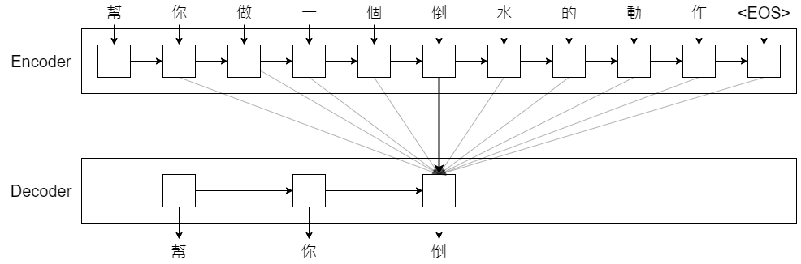
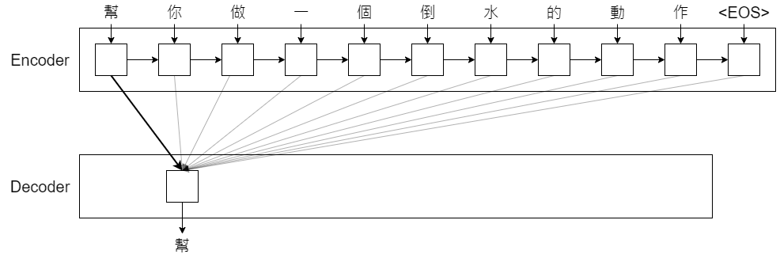



Transformer 簡介 (1 / 2)
什麼是 Attention？
讀取全局 => 關注重點

Slide 4
Transformer 簡介 (2 / 2)
Transformer
通常建構 Seq2seq 的架構為：
RNN: 存在梯度消失問題，且無法實現平行計算
CNN: 計算量和輸入、輸出序列長度成正比
Transformer 主打不使用 RNN、CNN，完全使用 Attention 架構 (Self-Attention)，即可迴避前述兩者的問題

Slide 5
Outline
Transformer 簡介
Introduction
Background
Model Architecture
Why Self-Attention
Results
Conclusion

Slide 6
Introduction (1 / 2)
Recurrent neural networks, long short-term memory and gated recurrent neural networks, have been firmly established as state of the art approaches in sequence modeling and transduction problems
This inherently sequential nature precludes parallelization within training examples, which becomes critical at longer sequence lengths, as memory constraints limit batching across examples.

Slide 7
Introduction (2 / 2)
In this work we propose the Transformer
Eschewing recurrence and instead relying entirely on an attention mechanism to draw global dependencies between input and output.
Allows for significantly more parallelization and can reach a new state of the art in translation quality

Slide 8
Outline
Transformer 簡介
Introduction
Background
Model Architecture
Why Self-Attention
Results
Conclusion

Slide 9
Background
Extended Neural GPU, ByteNet and ConvS2S
Use convolutional neural networks, computing hidden representations in parallel for all input and output positions.
The number of operations required to relate signals from two arbitrary input or output positions grows in the distance between positions
Self-attention
An attention mechanism relating different positions of a single sequence in order to compute a representation of the sequence
Transformer
First transduction model relying entirely on self-attention

Slide 10
Outline
Transformer 簡介
Introduction
Background
Model Architecture
Why Self-Attention
Results
Conclusion

Slide 11
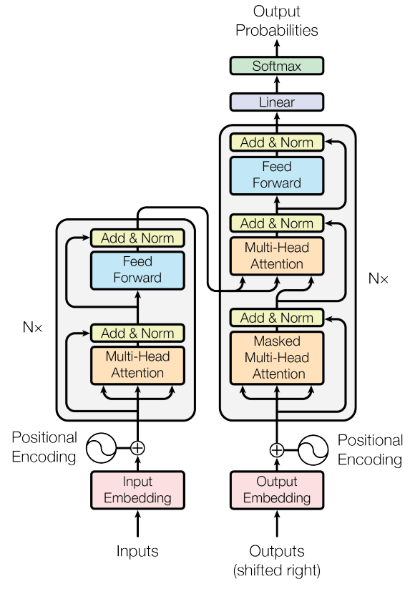
Model Architecture
Most competitive neural sequence transduction models have an encoder-decoder structure
At each step the model is auto-regressive
Transformer follows this overall architecture using stacked self-attention and point-wise, fully connected layers for both the encoder and decoder

Slide 12
Model Architecture - Encoder
N = 6 identical layers
Two sub-layers
A multi-head self-attention mechanism
A simple, position-wise fully connected feed-forward network
Employ a residual connection around each of the two sub-layers
All sub-layers in the model produce outputs of dimension d_{model} = 512

Slide 13
Model Architecture - Decoder
N = 6 identical layers
Decoder inserts a third sub-layer
multi-head attention over the output of the encoder stack
Masked Multi-Head Attention
Ensures that the predictions for position i can depend only on the known outputs at positions less than i

Slide 14
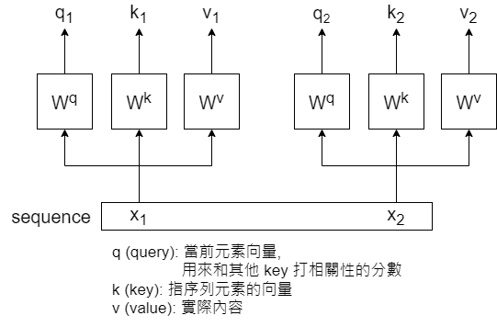
Model Architecture - Attention
Mapping a query and a set of key-value pairs to an output
The output is computed as a weighted sum of the values

Slide 15

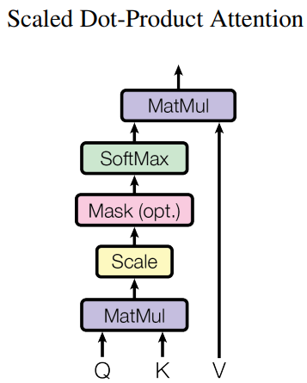
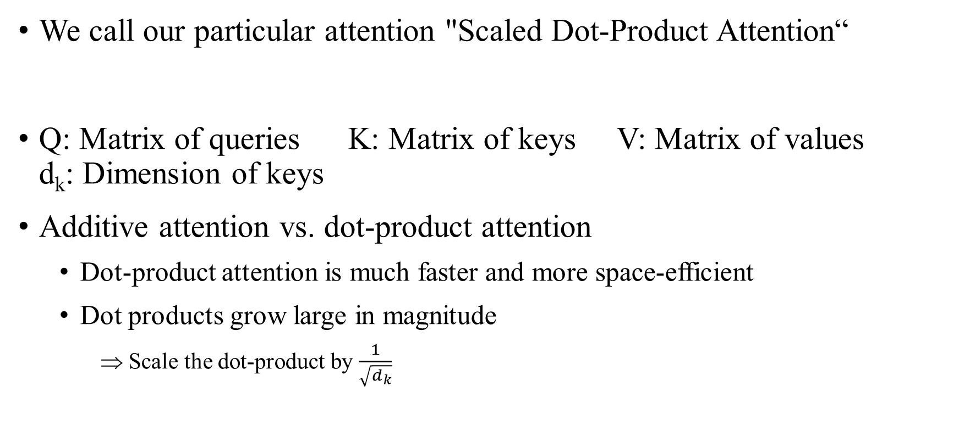
Model Architecture - Attention - Scaled Dot-Product Attention
We call our particular attention "Scaled Dot-Product Attention“
Q: Matrix of queries K: Matrix of keys V: Matrix of values d_{k}: Dimension of keys
Additive attention vs. dot-product attention
Dot-product attention is much faster and more space-efficient
Dot products grow large in magnitude
Scale the dot-product by $\frac{1}{\sqrt{d_{k}}}$

Slide 16
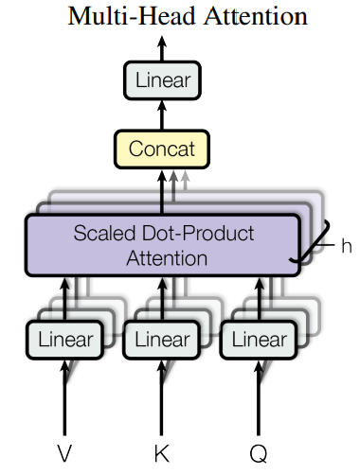

Model Architecture - Attention - Multi-Head Attention
We found it beneficial to linearly project the queries, keys and values h times with different, learned linear projections to d_{k}, d_{k} and d_{v} instead of performing a single attention function with d_{model}
In this work we employ h = 8
Due to the reduced dimension of each head, the total computational cost is similar to that of single-head attention with full dimensionality.

Slide 17
Model Architecture - Attention - Applications of Attention in our Model (1 / 3)
In "encoder-decoder attention" layers
Queries come from the previous decoder layer
Memory keys and values come from the output of the encoder
This allows every position in the decoder to attend over all positions in the input sequence

Slide 18
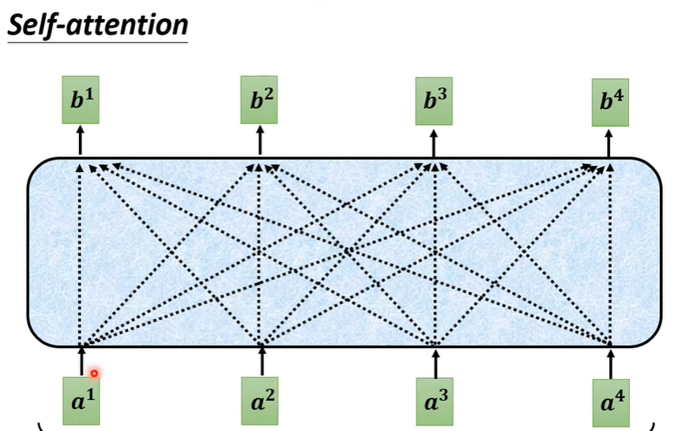
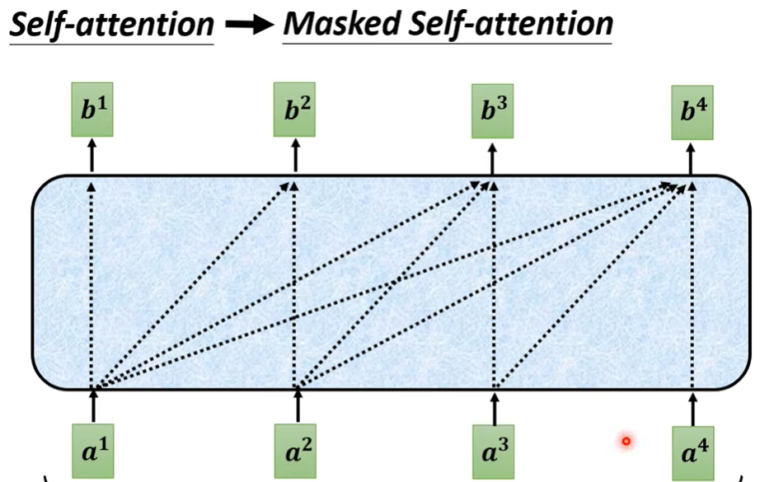
Model Architecture - Attention - Applications of Attention in our Model (2 / 3)
We need to preserve the auto-regressive property
Implement by masking out (setting to −∞) all values in the input of the softmax

Slide 19
Model Architecture - Attention - Applications of Attention in our Model (3 / 3)
Consists of two linear transformations with a ReLU activation in between

Slide 20
Model Architecture - Attention

Slide 21

Model Architecture - Positional Encoding (1 / 2)
To make use of the order of the sequence, we must inject some information about the relative or absolute position
pos: the position i: the dimension
This function would allow the model to easily learn to attend by relative positions
For any fixed offset k, PE_{pos+k} can be represented as a linear function of PE_{pos}

Slide 22
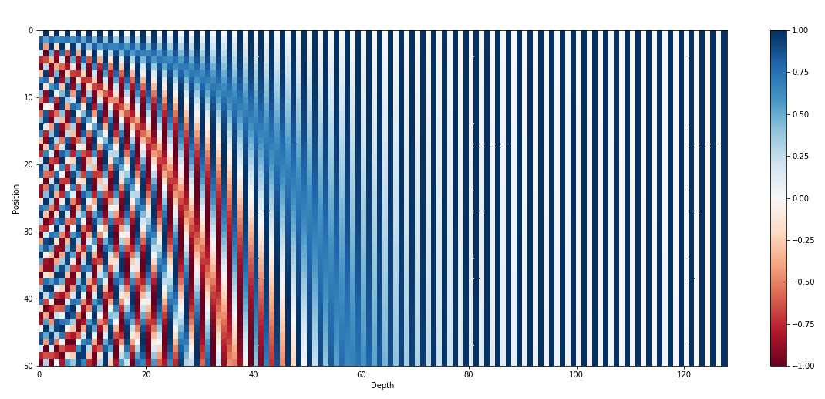
Model Architecture - Positional Encoding (2 / 2)

Slide 23
Outline
Transformer 簡介
Introduction
Background
Model Architecture
Why Self-Attention
Results
Conclusion

Slide 24
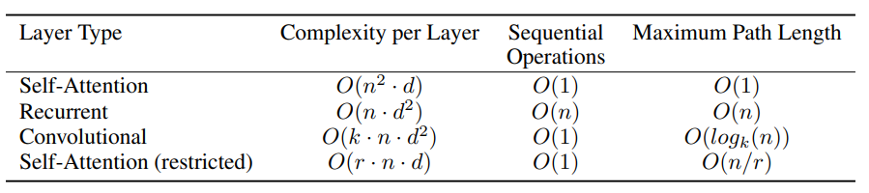
Why Self-Attention
Motivating our use of self-attention we consider three desiderata
The total computational complexity per layer
Amount of computation that can be parallelized, measured by the minimum number of sequential operations required
Path length between long-range dependencies in the network
n: Sequence length d: Representation dimension k: kernel size of convolutions r: Size of the neighborhood in restricted self-attention

Slide 25
Outline
Transformer 簡介
Introduction
Background
Model Architecture
Why Self-Attention
Results
Conclusion

Slide 26
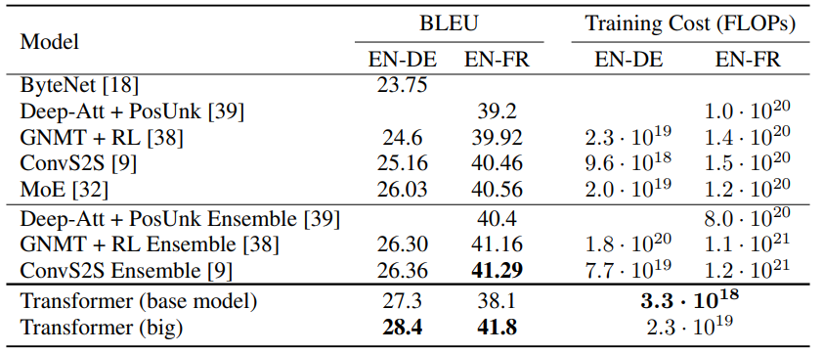
Result - Machine Translation
Training Data
WMT 2014 English-German, WMT 2014 English-French
Training Cost:
Training time × Number of GPUs × Sustained single-precision floating-point Capacity

Slide 27
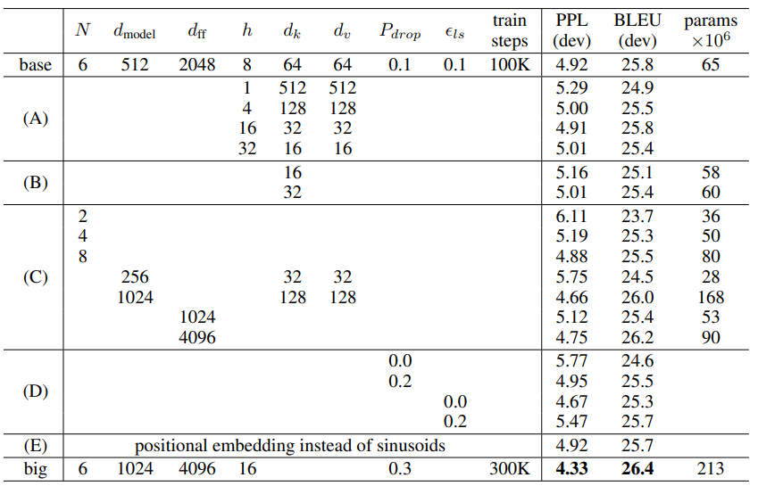
Result - Model Variations

Slide 28
Outline
Transformer 簡介
Introduction
Background
Model Architecture
Why Self-Attention
Results
Conclusion

Slide 29
Conclusion
We presented the Transformer, the first sequence transduction model based entirely on attention
Transformer can be trained significantly faster than architectures based on recurrent or convolutional layers
We plan to extend the Transformer to problems involving input and output modalities other than text and to investigate local, restricted attention mechanisms to efficiently handle large inputs and outputs such as images, audio and video

